Slide 1


Labs
IAS0220: Robotics guidance and software

Slide 2
General organization of the labs
Each week, after the lecture: 2h lab. If no lecture, still come at 12:30
Participation is not mandatory, but highly recommended
During the labs, you ask your questions about the tasks, or about the lectures
Warning: most tasks require some hard work, start as early as possible.
Submissions:
  No late submission (unless agreed before with the TAs). If late, you can send your work to the TAs for correction but the grade is 0.
  Check that your work compiles. If it doesn’t your grader can try to fix it but it’s not his/her responsibility
  Submit only relevant files
  Correct previous week’s mistakes
Submit quizz after every task
Bonus/Malus system:
  Bonus: participating in class, in the forum, giving feedback on the course, doing bonus tasks/bonus project. Bonus tasks: they add up to your grade for the task, and if you reach 100/100 it goes into a bonus account.
  Malus: submitting packages that do not compile

Slide 3
Workflow of tasks
After the lecture, you start the corresponding task
You submit 1 or 2 weeks later on Sunday evening (allowed up to Monday 10 am)
We check and grade your assignment before you submit the next one
You correct your mistakes before submitting the next assignment.

Slide 4
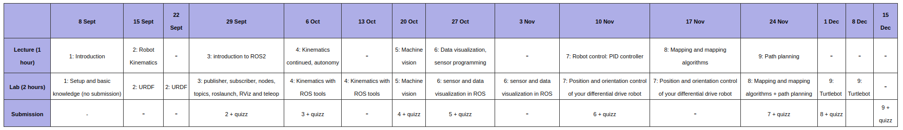
General organization of tasks
In total, there are 9 tasks
Most last 2 weeks, some only 1
Planning (subject to modifications)

Slide 5
Demonstration of the tools we use
Forum
  If you have a question or an unclear part that needs clarification
  You can, and are encouraged to answer to your classmates’ questions
  In english
Feedback about tasks
  too easy/too hard,
  topic covered not appropriate/you would have liked to learn another aspect
  you think there is not enough material or too detailed material
  you spotted any error, typo, missing link, etc...
  you think the task is very good and what aspects you found particularly interesting
  anything else

Slide 6
The teaching assistants team
Javier francisco.ortin@taltech.ee
Laura laura.piho@taltech.ee
Lauri lauri.vihman@taltech.ee
Simon simon.godon@taltech.ee
Yuya yuya.hamamatsu@taltech.ee
PS: if you want to be part of our team for next year (teaching module = 6ECTS), you can contact us!

Slide 7

See you in the labs!

